Slide 1
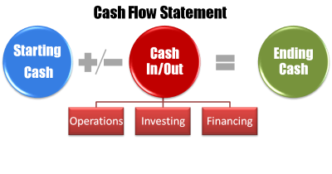
Lecture 10
STATEMENT OF
CASH FLOW

Slide 2
Learning Outcomes:
Upon successful completion of the session, students will be able to…
Differentiate between profit and cash flow;
Explain the importance of cash flow within the business and why company’s profit does not equal its cash;
Study the format of cash flow statement;
Describe the way in which the information in cash flow statement might help in the assessment of the current financial position of a company and its future prospects;
Derive a cash flow statement for an entity from its P&L account and Balance Sheets.

Slide 3
Companies are required by IAS 7
to include a cash flow statement in
their financial statements.
WHY?

Slide 4
Cash Flow Statement
Financial statement provides a reconciliation between the amount of profit generated during a period, and the amount by which cash balances have increased or decreased during that period

Slide 5
Need for Cash Flow Statement
The profit shown on the profit and loss account is not a good indicator of the cash or liquidity position of a company. Profitability and liquidity are not the same thing.
Although the balance sheet shows the cash balance at a given date, it does not show how the cash funds have been generated and used during the accounting year.

Slide 6
Purposes of Cash Flow Statement
Helps understand relationship of net income to changes in cash balances
Reports past cash flows for:
  Predicting future cash flows
  Evaluating how management generates and uses cash
  Determining firm’s ability to pay interest, dividends, and debts when due
Identifies changes in assets of a firm

Slide 7
Income statement for 2019
Cash flow statement for 2019
Balance sheet at 31.12.2018
Balance sheet at 31.12.2019

Slide 8
What might be the reasons for the difference between profit and cash?

Slide 9
Main reasons for the difference:
Purchases and sales are often made on credit terms, there may be delays in paying for services provided, and some services may be paid in advance.
Some items included in the P&L account do not affect the cash position, e.g. depreciation, bad debts and so on.
Issue of shares and the purchase of fixed assets are not recorded in the P&L account.

Slide 10
Definition of CASH
Under FRS1 the term “cash” means cash on hand and deposits available on demand.
Fixed deposits are not included under the term “cash”.

Slide 11
Sources of Cash:
  Operating profit
  Sales of fixed assets/investments
  Increase in creditors
  Decrease in stock
  Decrease in debtors
  Capital introduced
  Loans received
Uses of Cash:
  Losses
  Purchase of fixed assets/investments
  Decrease in creditors
  Increase in stock
  Increase in debtors
  Buying-back (redeeming) of shares
  Loans repaid
  Payment of dividends

Slide 12
Cash Flow Statement Format
There are two formats of cash flow statement:
Direct – when Cash Book is used to determine all cash receipts and cash payments.
Indirect –Income statement and Balance sheet are used to drive CFS.
Most businesses use In-direct method, therefore it will be used in tutorials and for assessment purposes.

Slide 13
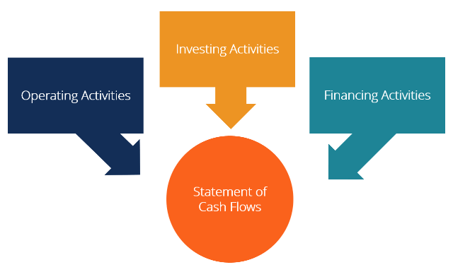
Cash Flow Statement

Slide 14
Cash Flow Statement
Operating activities – are actions of buying and selling goods, or manufacturing goods for resale, or providing a service to customers.
Investing activities – are the actions of buying and selling fixed assets for long-term purposes.
Financing activities – are the actions of raising and repaying the long-term finance of the business.
  Obtain resources by either of the following methods
    Borrowing from creditors
    Selling shares of stock
  Use resources to for either of the following purposes
    Repay creditors
    Provide a return to shareholders

Slide 15
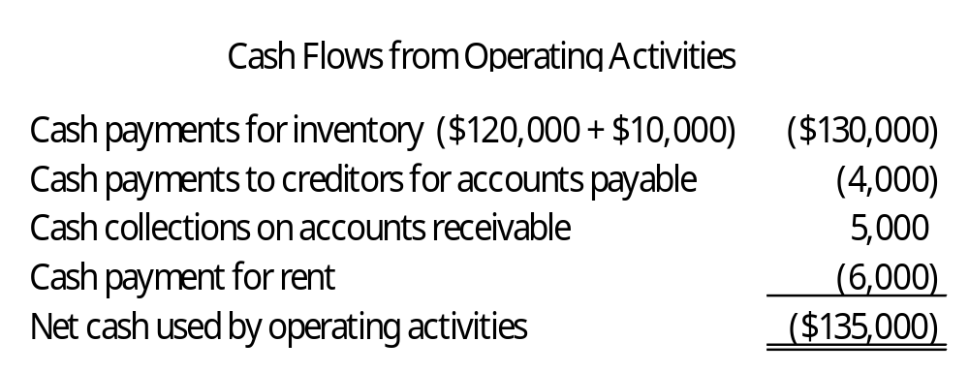
Cash Flows from Operations —The Direct Method
Consists of a listing of cash receipts (inflows) and cash disbursements (outflows)
Constructed by examining cash column of balance sheet equation
Example

Slide 16
Cash Flows from Operations The Indirect Method
Used to understand how the cash flows from operating activities differ from net income
Operating statement:
  Starts with net income
  Adds or subtracts a series of adjustments
  Ends with cash provided by (used for) operating activities

Slide 17
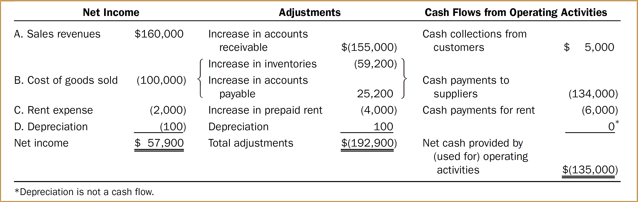
Cash Flows from Operations The Indirect Method

Slide 18
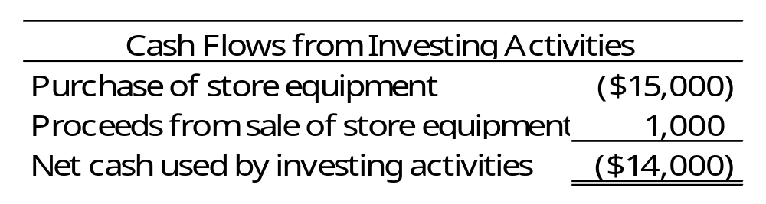
Cash Flows from Investing Activities
Examples of investing activity
  Acquire store equipment for cash, $15,000
  Sale of asset for cash, $1,000

Slide 19
Cash Flows from Investing Activities
Two general rules for investing activities
Sale of long-lived assets, collecting loans, and sales of investments
In cash
Purchase of long-lived assets, granting loans, and purchases of investments
In cash

Slide 20
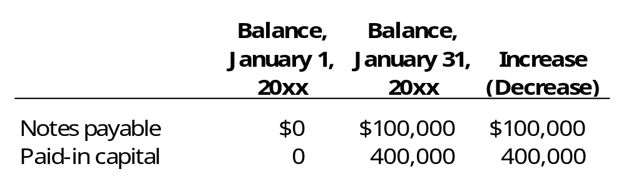
Cash Flows from Financing Activities
Examples of financing activities
  Initial investment, $400,000
  Loan from bank, $100,000
Cash flows from financing activities

Slide 21
Cash Flows from Financing Activities
Two general rules for financing activities
  In liabilities or paid-in capital
In cash
  In liabilities or paid-in capital
In cash

Slide 22
Indirect Format
FRS 1 requires the items that are normally contained in a cash flow statement to be classified/grouped under seven headings in the following order:
Net cash flow from operating activities
Returns on investments and servicing of finance
Taxation
Capital expenditures
Equity dividends paid
Management of liquid resources
Financing

Slide 23
Reconciliation of Operating Profit
Operating Profit
Depreciation charges
Loss/(profit) on sale of tangible fixed assets
(Increase)/decrease in stock
(Increase)/decrease in debtors
Increase/(decrease) in creditors
Increase/(decrease) in provision for bad and doubtful debt
1. Net cash inflow/outflow from operating activities

Slide 24
Reconciliation note 1:
start with operating profit;
(b) then adjust for non-cash items in the profit and loss account;
(c) then adjust for working capital items (in the balance sheet) which involve inflows or outflows of cash.

Slide 25
Non-cash items
Provision for depreciation – needs to be added back to the profit.
Provisions for bad and doubtful debts – increase in the provision has to be added back; decrease in the provision has to be deducted.
Loss/(profit) on sales of fixed assets:
  Loss is added back
  Profit is subtracted

Slide 26
Ex: Profit/loss on sales of FA
book profit – a fixed asset, book value $5,000 is sold for $6,400 cash, the flow of cash is $6,400 only. The book profit of $1,400 does not provide any more cash above the figure of $6,400. Therefore the book profit should be deducted from the net profit figure.
book loss – an asset, book value $3,000 is sold for $2,200 cash, the flow of cash is $2,200. The book loss of $800 does not mean there is an outflow of $800. Therefore book loss should be added back to the net profit figure.

Slide 27
Uses of CFS
Explains why a business may have reasonable profit but still have low cash resources
How far a business will be able to meet future commitments which require cash payments, e.g. tax due, interest payments
Analysis of main sources and uses of cash funds in an entity’s activities
How far future share issues may be needed or additional capital in case of sole traders & partnerships.

Slide 28
Lecture Roundup:
Statements of cash flows are a useful addition to the financial statements of companies because it is
recognised that accounting profit is not the only indicator of a company's performance. They concentrate on the sources and uses of cash and are a useful indicator of a company's liquidity and solvency.
You need to be aware of the format of the statement as laid out in IAS 7. Setting out the format is the first step. Then follow the step by step preparation procedure

Slide 29
References:
Dyson, J.R (2004) Accounting for Non-Accounting Students, chapter 8.
Wood F & Sangster A, Business Accounting 1, chapter 39.
Perks, R (2004) Financial Accounting for Non-specialists, chapter 7.
Glautier, M & Underdown B (2001) Accounting Theory and Practice, 7th edition, chapter 15
ACCA (2006) Approved text for the professional qualification, Study Text 2006/07, Paper 1. INT,Kaplan publishing: Foulks Lynch, chapter 22.
Britton, A. & Waterson, C. (2003) Financial Accounting, Pearson Education Limited, third edition, chapters 9.
Weetman, P. (1996) Financial Accounting, an Introduction, Pitman Publishing, chapters 3,7.
ACCA (2017) Approved Interactive Text. Foundations in Accountancy FFA 2017/2018. BPP Media Ltd.

